Slide 1
Constrains in wheat production

Slide 2
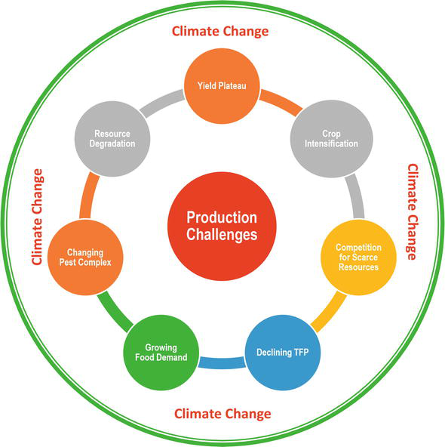

Slide 3
Climatic vulnerablity
In India a significant part of wheat area is under heat stress, and Gangetic plains and central and peninsular India are the most heat-stressed regions, whereas it is moderate in northwestern parts of Indo-Gangetic Plains
it has been predicted that with every rise in 1°C temperature, the wheat production will be decreased by 4–6 million tonnes.
Rainfed wheat will experience a reduction in yield with 9–25% profit loss for every 2–3.5°C rise in temperature

Slide 4
Excessive use of inputs and land resources
After the Green Revolution, the productivity of wheat has been significantly increased with the increase in input usage, plant protection chemicals and irrigated areas. The excessive use of fertilizer, chemicals and irrigation has degraded the fertility of the soil and also caused a reduction in groundwater table. The monocropping system led to deterioration in soil quality. If the current trend continues, the country will face a serious problem in utilization of scarce natural resources.

Slide 5
Salt-affected and problematic soils
In India about 4.5 million hectares salt affected area is under wheat cultivation posing a major problem for canal irrigated areas [21]. Even though soil amendments and proper drainage are the more constructive solution, pace of reclamation is not substantial. This will significantly reduce the wheat yield.

Slide 6
Pest and disease complex
As year passes, the pests of wheat have developed some resistance even though controlled under contingent situation. If not, a new range of pests and diseases have been emerging putting a serious constraint on the wheat productivity.

Slide 7
Availability of improved seed
Adoption system and germplasm dissemination in India have been made in formal (organized) and informal (unorganized) ways [22]. Even though new improved varieties are developed and made available to farmers by NARS around, 80% of all seeds are saved by the farmers [19]. Further, a majority of farmers in India have lack of awareness of improved wheat varieties due to weak linkages [19]. The development and diffusion of improved varieties are crucial for achieving target production of wheat.

Slide 8
Price volatility
Volatility in prices of agricultural commodities has received considerable attention in the recent past among producers, consumers and policy makers. Price fluctuations create an uncertain farming situation threatening wheat production and have a negative impact on the welfare of wheat growers. Further, volatility in prices of wheat in international market hinders the smooth flow of trade across nations.

Slide 9
Decline in farm size
Over the years, a visible declining trend in farm holding size has been observed and is another major concern for the nation as a whole. This is caused by fragmentation of farmland owing to nuclear family system and decline in cultivable area due to urbanization. Estimate from the agricultural census (2010–2011) reports that the average operational holding in India was 1.16 ha. Among major wheat-growing states, average operational holding was highest in the case of Punjab (3.77 ha) and lowest in Bihar (0.39 ha). Declining farm size and conversion of farmland to residential area are the major setbacks with respect to food production in general and wheat production in particular.

Slide 10
Declining total factor productivity
A major concern among policy makers is the declining total factor productivity over the years owing to stagnating yield levels with increased use of inputs and resource services. It is a major concern in the intensive cropping areas wherein rice-wheat is widely under cultivation. This can be countered by adoption of improved technologies coupled with the use of optimal resources.

Slide 11
Zone | Major production constraints
Northern hills zone | Lack of accessibility of seed of newly released variety, Phalaris minor, small land holdings, high cost of inputs, non-availability of farm machinery, yellow rust, birds, lack of knowledge among the farmers about recent technologies, imbalanced use of fertilizer, lack of irrigation facilities
Northwestern plains zone | High cost of inputs, low price of wheat, erratic power supply, Phalaris minor, low organic matter in the soil, poor quality of seeds, non-availability of labour, untimely rain, Chenopodium album, non-availability of electricity
Northeastern plains zone | Small land holdings, inadequacy of seeds of newly released variety, lack of information among the farmers about recently developed new technologies, late sowing, temperature fluctuations during growth, high-priced inputs, poor quality of seeds, non-availability of labour, low organic matter in the soil, non-availability of farm machinery
Central zone | Non-availability of labour, imbalanced use of fertilizer, high temperature at maturity, limited accessibility to seed of newly released variety, temperature fluctuation during crop growth, high cost of inputs, lack of irrigation facilities, small land holding, decline in water table, untimely rain
Peninsular zone | Low price of wheat, irregular power supply, high cost of inputs, non-availability of labour, non-availability of electricity, higher rate of custom hiring, untimely rain, lack of facilities of canal irrigation, poor accessibility to seeds of newly released variety, temperature fluctuation during crop growth

Slide 12
Wheat frontline demonstrations (WFLDs) during 2018-19
FLD - Front Line demonstrations(FLDs) is a unique approach to provide an direct interface between researcher and farmers as the scientists are directly involved in planning, execution and monitoring of the demonstrations for the technologies developed by them and get direct feedback from the farmers’ field about the crops like wheat, rice and pulses production in general and technology being demonstrated in particular.

Slide 13
OBJECTIVES
To demonstrate improved Crop Production Technologies of Rice, Wheat and Pulses on the farmers’ fields;
To popularize the newly notified and improved varieties/technologies for varietal diversification and efficient management of resources.
To bring synergy among planers, researchers, farmers and industry for parable interface through seminars/symposium on emerging themes of importance in the field of Rice, Wheat and Pulses production for deciding strategies for development of these crops.

Slide 14
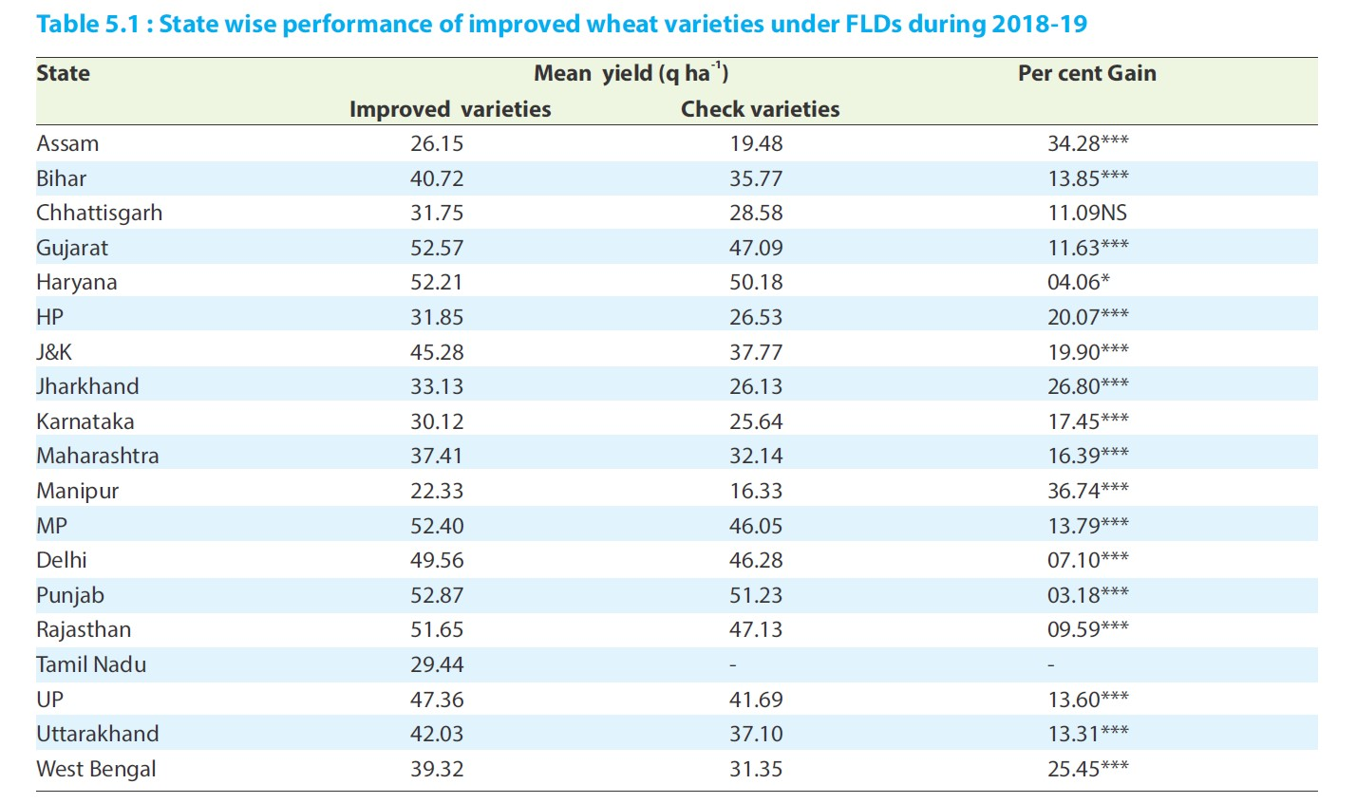

Slide 15
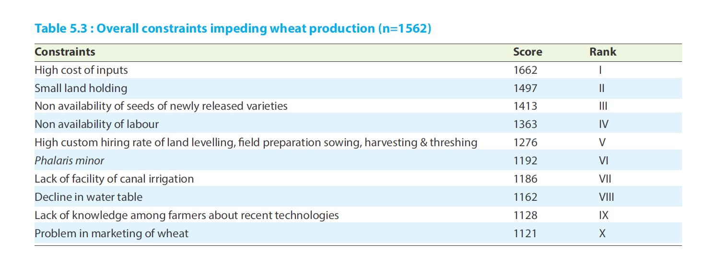

Slide 16
Analysis of constraints in different wheat producing zones of India
Northern Hills Zone (NHZ):
In NHZ, small land holding, high cost of inputs, untimely rain, Phalaris minor, non availability of labour were the major constraints faced by the farmers of northern hills zone.

Slide 17
North Eastern Plains Zone (NEPZ):
Among major constraints
of this zone, high cost of inputs, higher custom
hiring charges, non-availability of farm labours,erratic power supply, poor information delivery by the state extension machinery and Phalaris minor were identi􀃶ed.
Migration of farm labour from eastern zone to other parts of the country is creating scarcity of agricultural labourers in this zone.
Marketing of wheat is still a concern for this region for better price realization and pro􀃶tability.

Slide 18
North Western Plains Zone (NWPZ):
non-availability of seed of newly released varieties was identi􀃶ed as the most serious constraint.
In addition to this, small land holdings, declining
water table, low organic matter in the soil were also given high priority.

Slide 19
Central Zone (CZ):
In central zone, high cost of inputs, decline in water table, low price of wheat, small land holdings and problem in marketing were the major constraints faced by the farmers. This zone has been identi􀃶ed as export zone for quality wheat. The processing quality of wheat in this zone is better than that of NEPZ and NWPZ. The above said constraints need to be addressed seriously for more income.

Slide 20
Peninsular Zone (PZ):
In peninsular zone, higher rate of custom hiring, low price of wheat, water stress, high cost of inputs and high temperature at maturity were the major constraints of this zone. For making wheat cultivation remunerative, there is a need to develop proper market. For better price realization farmers need to be educated about selling of their agricultural produce through e-NAM portal.

Slide 21
Overall Constraints: The overall analysis of constraints
across zones revealed that high cost of inputs, small land holding, non-availability of seed of newly released varieties, non-availability of labour; higher customer hiring rate of land levelling, field preparation, sowing, harvesting and threshing; and Phalaris minor were the major constraints of wheat production as identified under FLDs.

Slide 22
Farmers need to be educated and trained on recent wheat production technologies, complete package of practices and soil health management. There is a need of government intervention to ensure quality seeds as well as quality inputs. Farmers need to be updated on impact of climate change on wheat cultivation and what are the coping strategies they can adopt to mitigate it. The concept of conservation agriculture and adoption of resource conservation technologies at farmer’s field can be propagated at a larger scale. To ensure better price, farmers have to go for quality wheat production. There is a need to register wheat growers on e-NAM platform for selling of wheat. All the constraints need appropriate attention in order to increase wheat production in all major wheat producing zones of the country.

